Slide 1

Start thinking about your final project and book a one-on-one meeting
The final project’s goal is to answer a well-defined scientific question by applying one of the ML algorithms introduced in class on an environmental dataset of your choice (e.g., related to your Masters thesis or your PhD research).
Can you think of a large environmental dataset linked to a scientific question you are passionate about?
In the affirmative, how could you format the dataset to facilitate its manipulation in Python?
In the negative, consider browsing the Pangeo’s (http://mldata.pangeo.io/index.html), Kaggle’s, class syllabus’, or previous years’ datasets
Notes:
Questions?

Slide 2


Welcome back! Min 15-30: Quiz
ML for Earth & Env Sci (Week 2, SP2022)
Learning Objectives (Moodle Quiz at Min 45 on Géron Ch5+6+7):
Name Support Vector Machines & understand their applicability
Know how to train & interpret a decision tree
Understand how to choose a regularization hyperparameter
Define a random forest
Know some advantages/drawbacks of ensemble modeling
Understand feature importance
One-on-one meetings will be on Zoom this afternoon
If you have not had the chance to set up a one-on-one meeting, please email me (and cc the TAs)
No guest lecturer (forgot to correct from last year)
Notes:
Thank you:
For coming today
To all of you who did the guided readings
For persevering

Slide 3
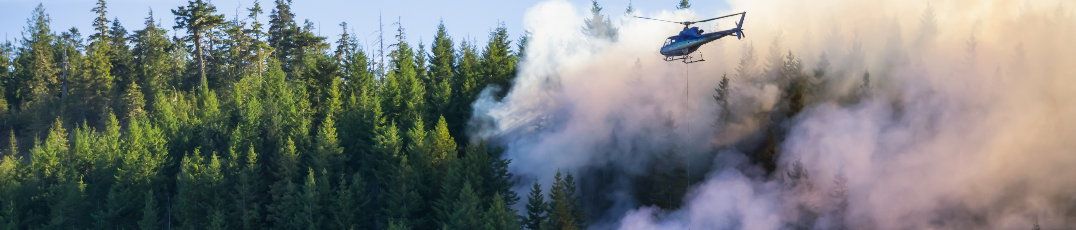
Min 30-60: Susceptibility mapping of Environmental Hazards using ML
Image
Re-read the article and write down (1) the scientific goal of the paper; (2) One simple question with your neighbor. Example: What is a susceptibility map?
Image Source: edb3_16

Slide 4
According to past data, which locations of the Liguria region are most susceptible to wildfires?
Problem: - Traditional susceptibility maps are not informed by data
- Statistical models only use a few years & do not separate by seasons
Idea: Train random forest to detect wildfires for 21y & use resulting probab.
Result: Susceptibility map indicating likelihood of wildfire events

Slide 5

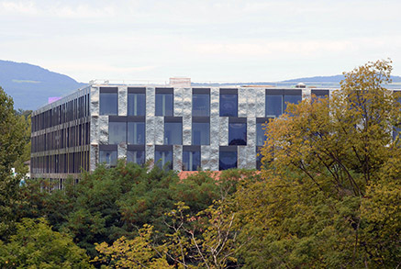
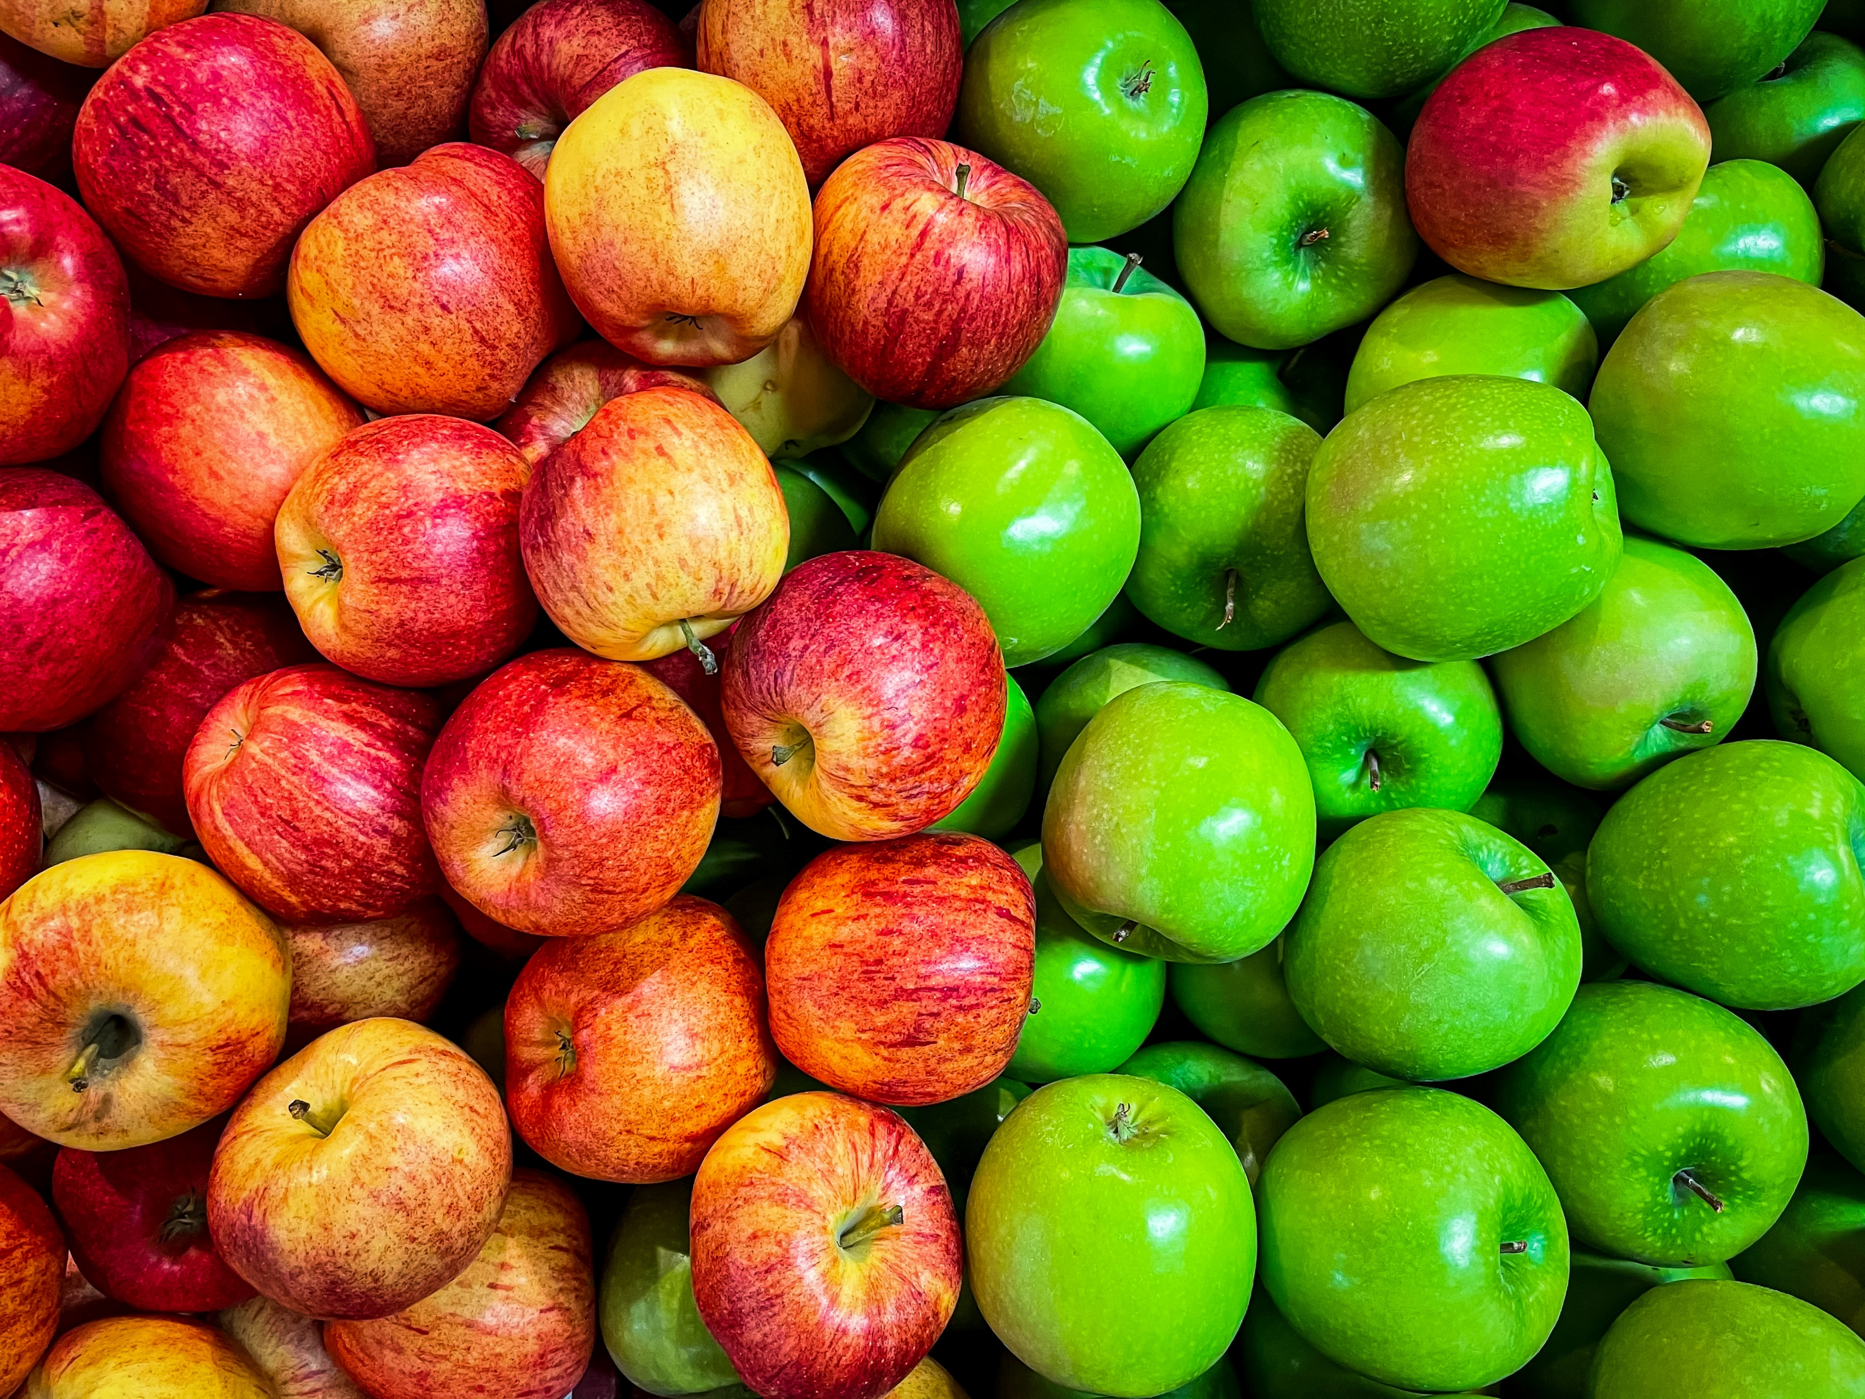
Min 60-75: Break

Slide 6
ML for Earth & Env Sci (Week 3, SP2022)
How would you use high-dimensional environmental data to train machine learning algorithms?
Source: https://vimeo.com/129246923, McClean et al. (2011)
Notes:
First we see the SST, highlighting the fine-scale eddies and filaments present in the simulation.
Then we see density transformation by surface heat fluxes.
Finally we see density transformation by near-surface lateral mixing.

Slide 7
Min 75-90: Unsupervised Learning for Dimensionality Reduction
Learning Objectives (Géron Ch8):
Distinguish supervised from unsupervised learning
Understand the necessity of reducing dimensionality for big datasets
Know at least two approaches for dimensionality reduction
Understand the steps of Principal Component Analysis

Slide 8
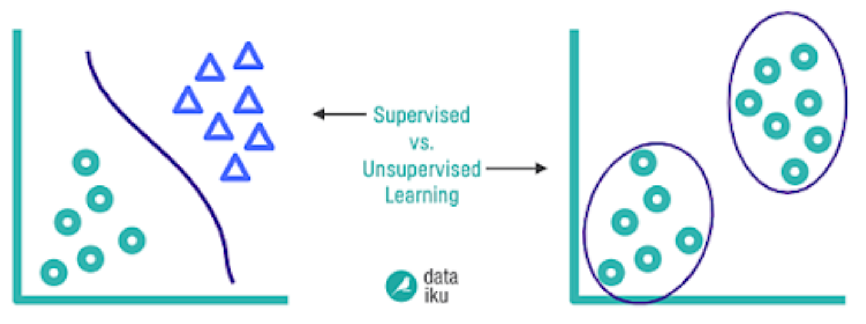
Supervised Learning:
Training set includes desired solutions (labels)
Unsupervised Learning:
Training data is unlabeled
“Learning without a teacher”
Source:
Notes:
VOTE 2) Distinguish supervised from unsupervised
See Géron Ch2 for semisupervised learning, reinforcement learning
Offline vs Online learning
Instance-based vs model-based learning

Slide 9


When do we need to reduce dimensionality?
So many possible inputs!
?
How cold will European Winter be?
Surface temp (x,y,t)
Ocean currents (x,y,z,t)
Notes:
First we see the SST, highlighting the fine-scale eddies and filaments present in the simulation.
Then we see density transformation by surface heat fluxes.
Finally we see density transformation by near-surface lateral mixing.

Slide 10
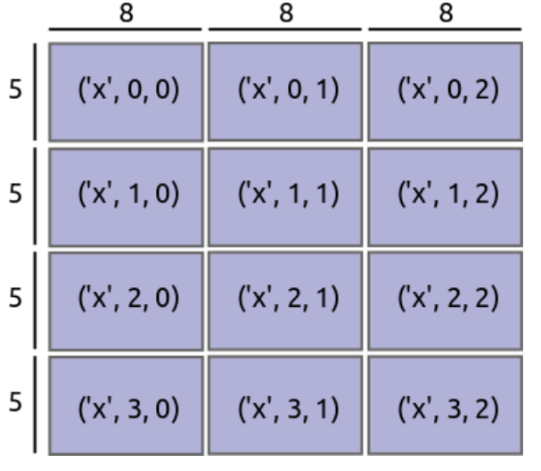
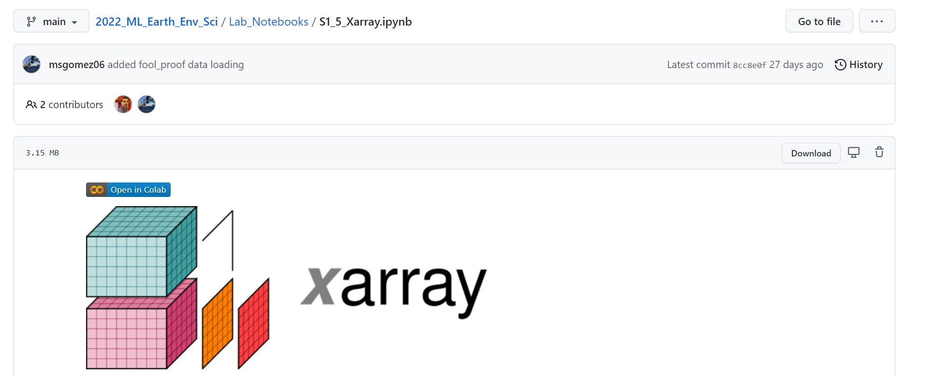
What if the data don’t even fit into memory?
xr.open_mfdataset can build pointers to multiple files whose total size far exceeds the RAM!
Can use “dask=True” for parallelization

Slide 11
Start with simple statistics!
Global mean surface temperature (t)
Global standard deviation surf. temp (t)
Regional mean surface temperature - Atlantic Ocean temp. (t) - Pacific Ocean temp. (t) - etc.
Play with spatiotemporal coordinates and with various statistical moments (mean, variance, skewness, kurtosis, etc.)
Surface temp (x,y,t)
Ocean currents (x,y,z,t)
Can we be more objective?
Notes:
VOTE

Slide 12
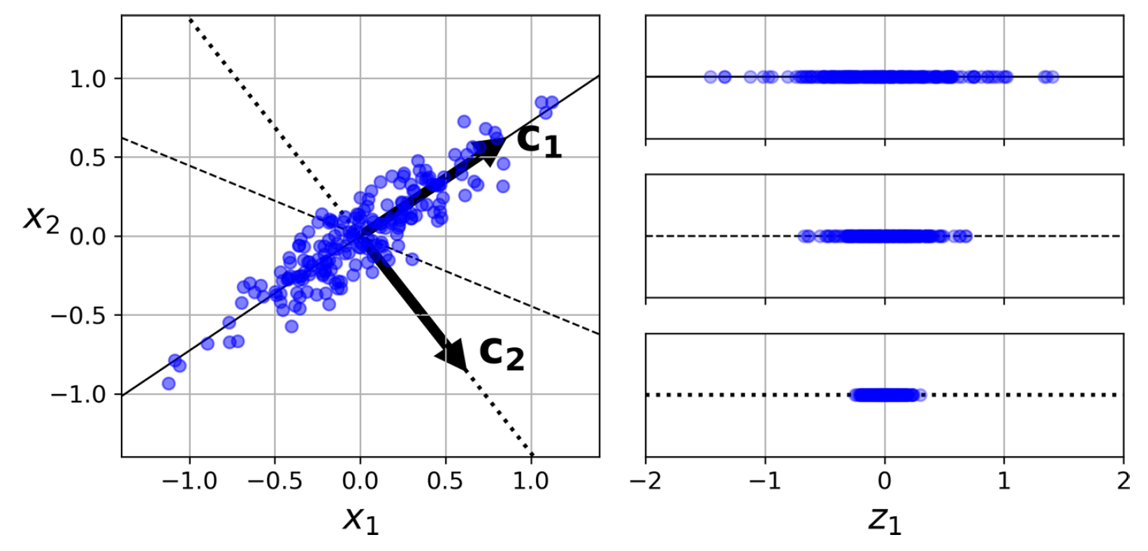
Principal Component Analysis: Decomposing variables to maximize explained variance
First principal component
Second principal component
Notes:
VOTE

Slide 13
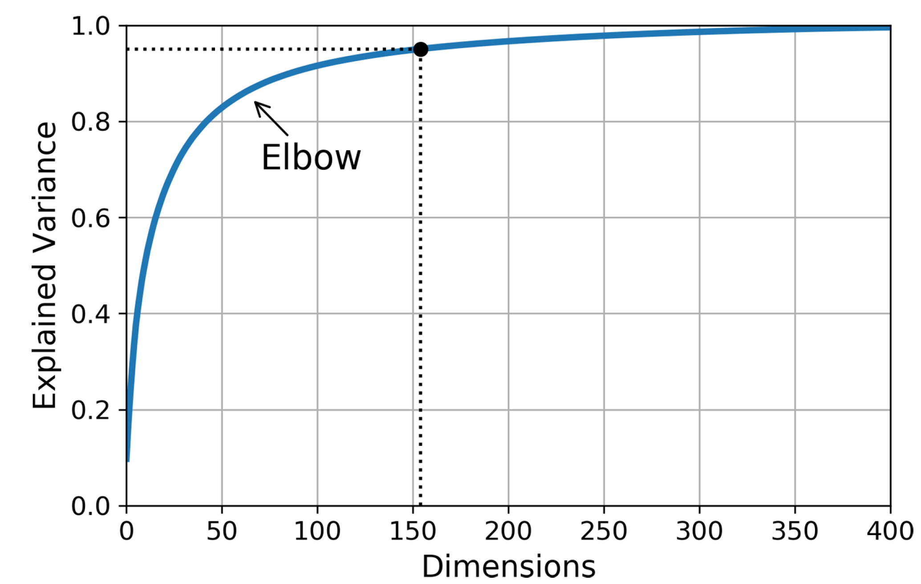
How to choose the number of components?

Slide 14
How to proceed step-by-step?
1. Apply SVD (single value decomposition)on the matrix X to find the matrix of unique vectors V (contains all principal components)
2. Once V is found, you can choose the number of dimensions you want to keep to maximize the variance
3. In the end, matrix multiply the centered X with the transpose V containing the number of dimensions chosen
I would use scikit learn's PCA.
1. I would plot a graph of explained variance / number of dimensions to choose how many dimensions to keep
2. pca = PCA(n_components = chosen number)
3. da = pca.fit_transform(my_data) to fit it on my data.

Slide 15
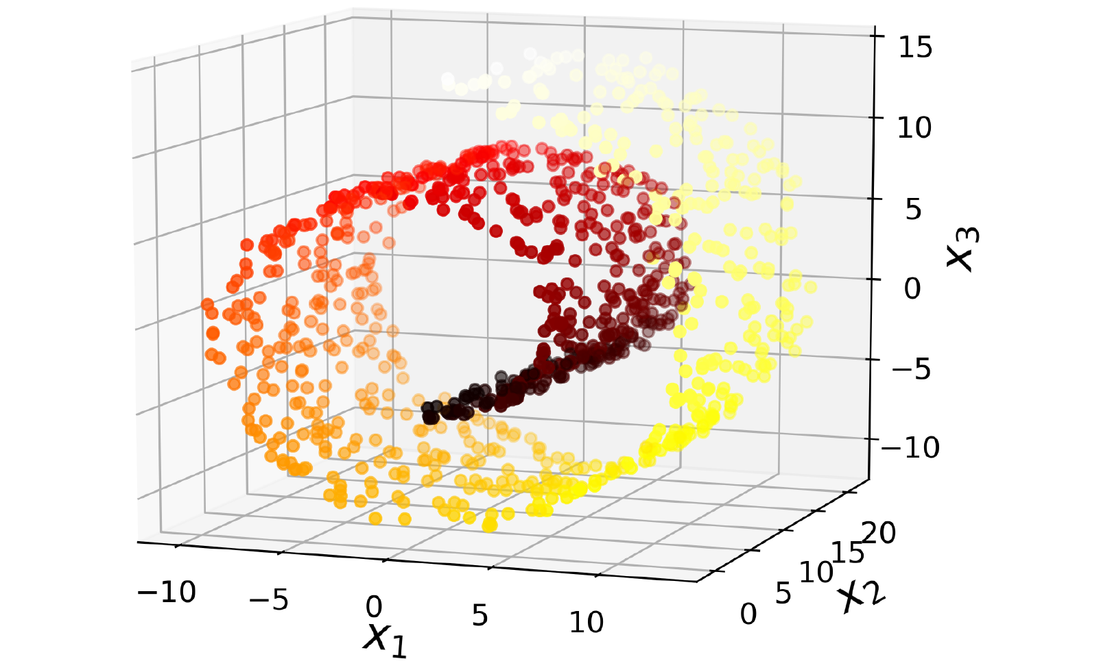

Other Approaches for Dimensionality Reduction
Source: deliciousmagazine.co.uk

Slide 16
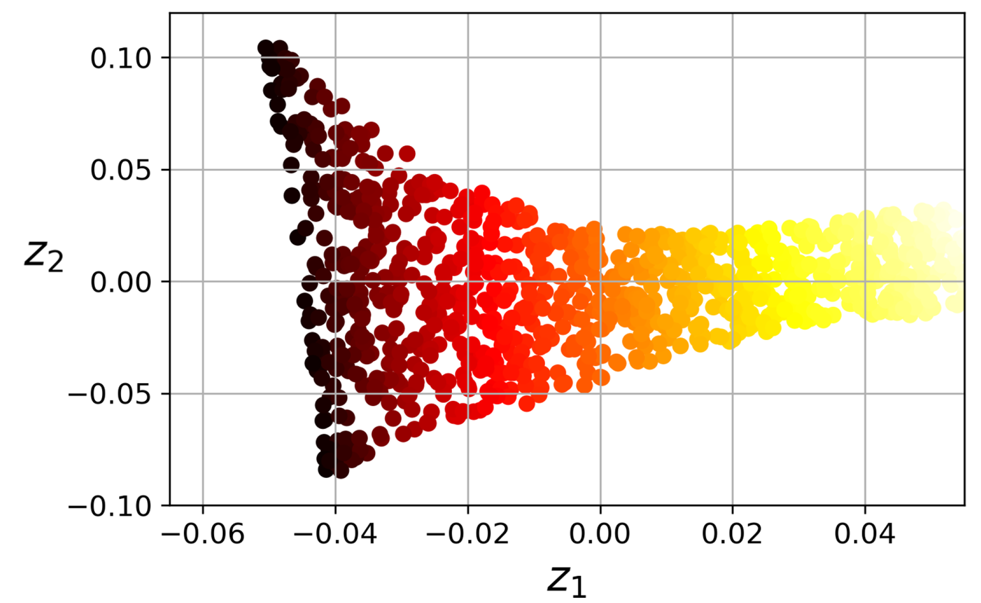
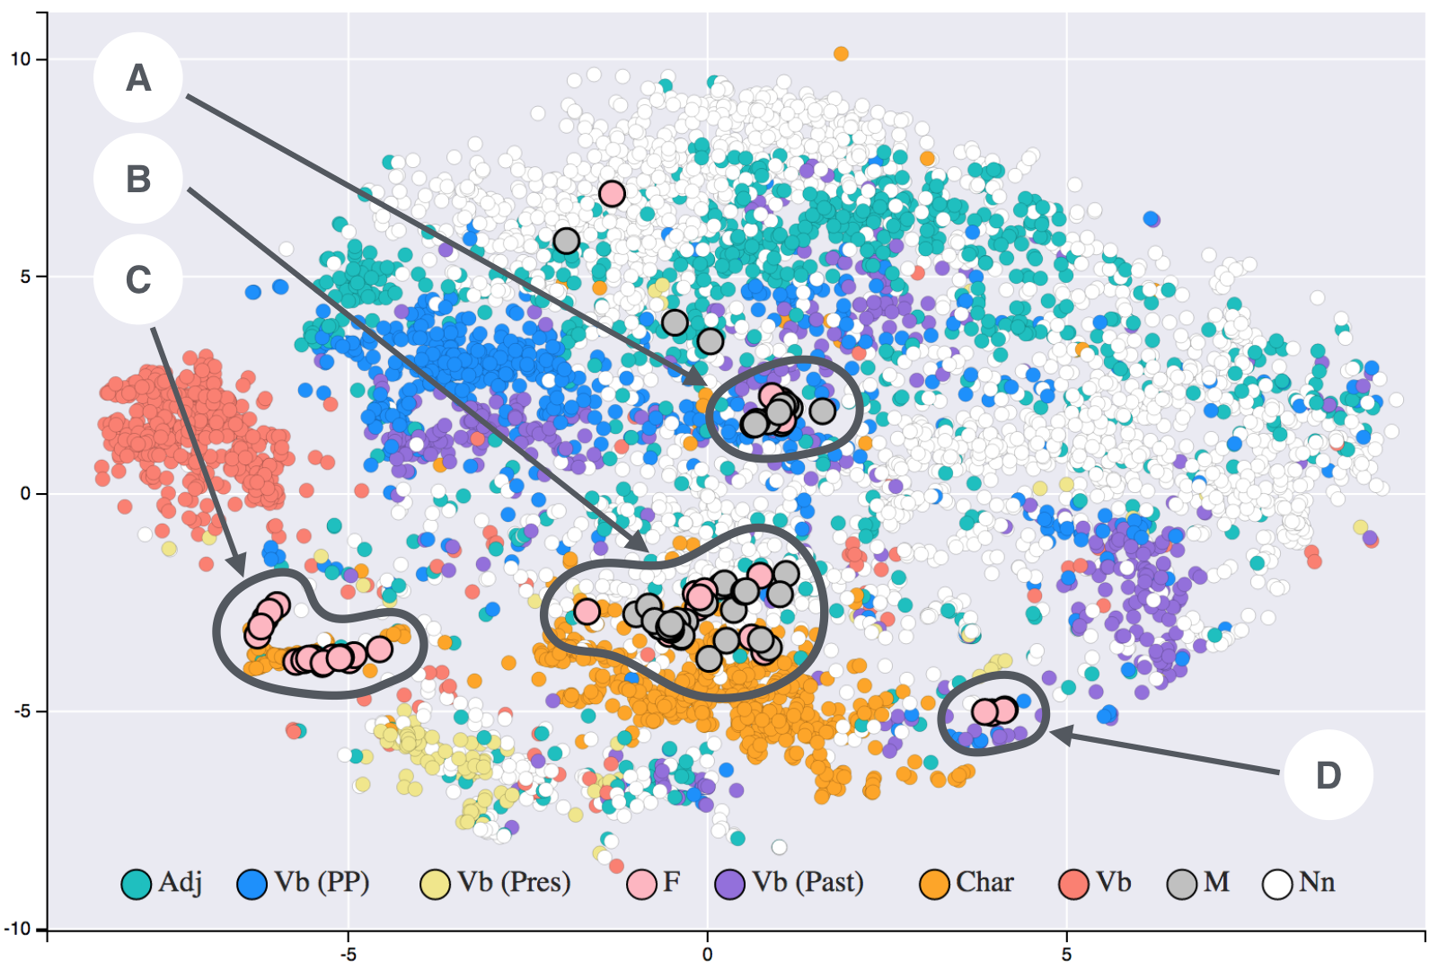
Other Approaches for Dimensionality Reduction
Locally Linear Embedding (LLE)
t-SNE:
t-Distributed Stochastic Neighbor Embedding
Source: Siobhán Grayson (Wikipedia, T-SNE)
Notes:
Word embedding algorithms derive a set of real-valued vectors representing the vocabulary of a text corpus in a new embedded space. This provides a useful means of measuring the underlying similarity between words. This image consists of word embeddings generated from 19th century literature.

Slide 17
Min 90-105: Unsupervised Learning for Clustering & Anomaly Detection
Learning Objectives (Géron Ch9):
Distinguish clustering from supervised classification
Know how to implement the K-means algorithm and select the number of clusters
Know how to implement Gaussian mixture models and how to detect anomalies

Slide 18
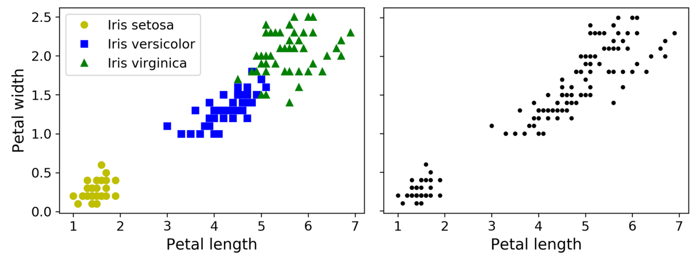
Supervised Classification versus Clustering
Notes:
VOTE

Slide 19
Supervised Classification versus Clustering Data Analysis, Dim. Red., Anomaly Detection, etc.

Slide 20
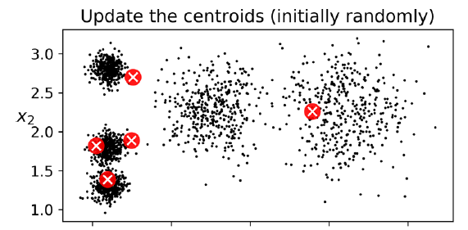

Slide 21
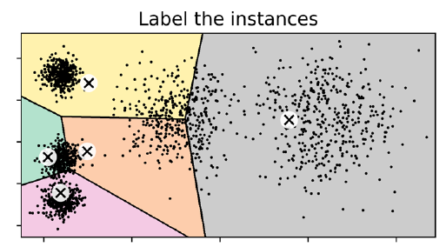

Slide 22
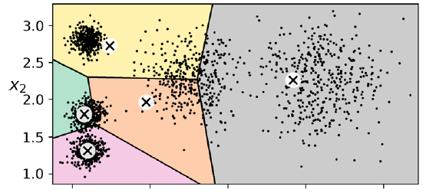

Slide 23
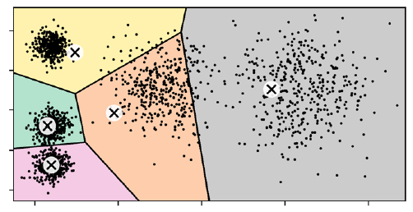

Slide 24
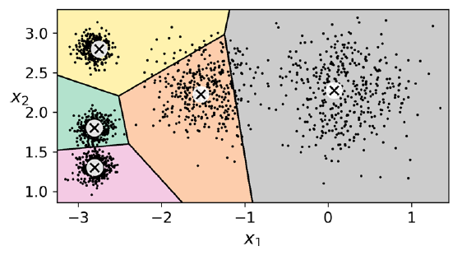

Slide 25
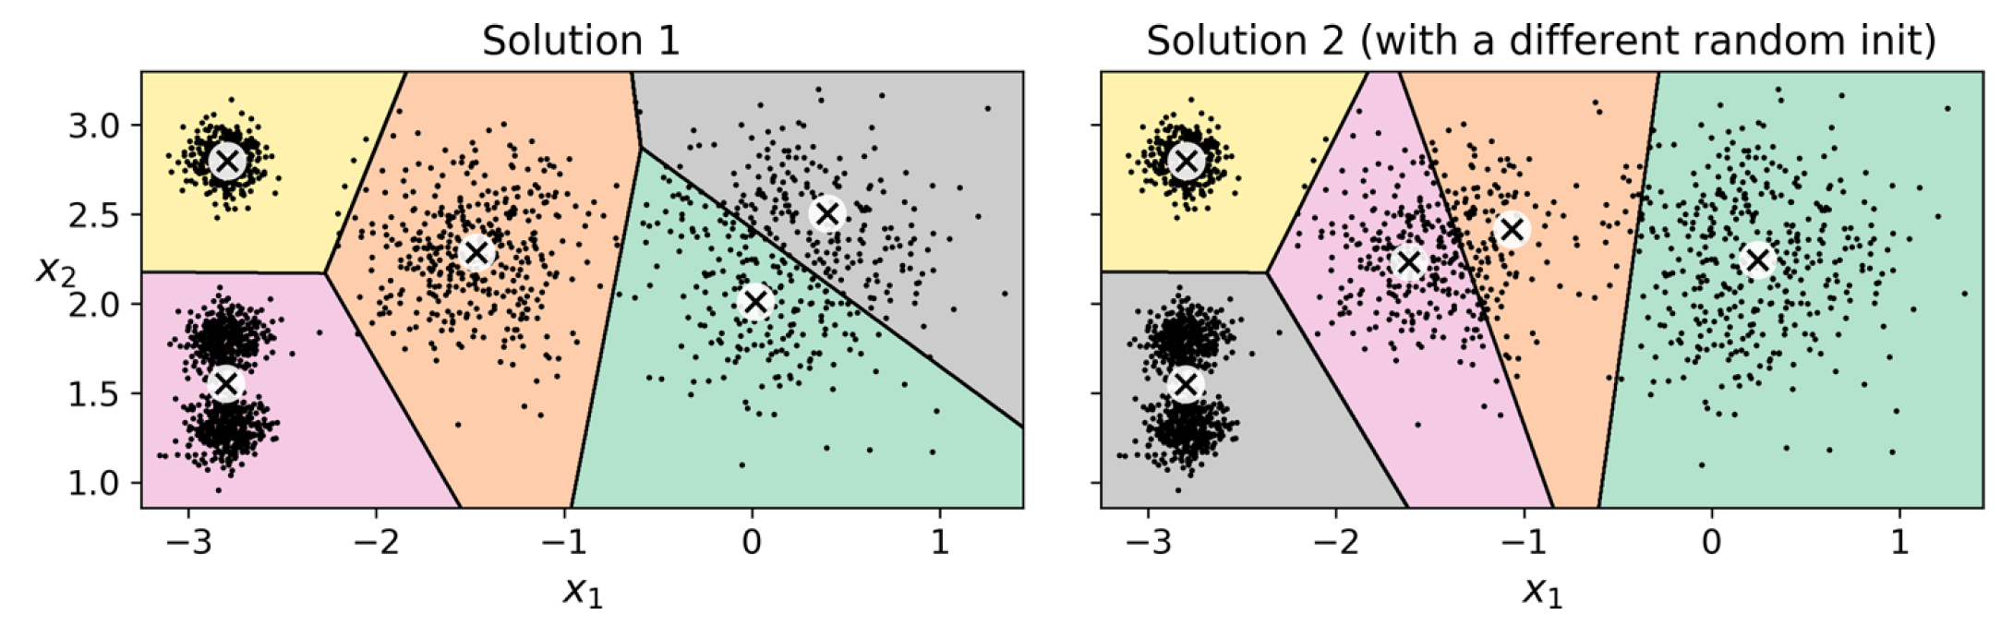
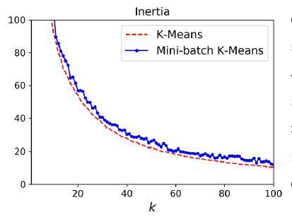
Iteratively minimizing the inertia (mean square distance to the closest centroid) does not guarantee a unique solution!
For reproducibility: Save your centroids ☺

Slide 26
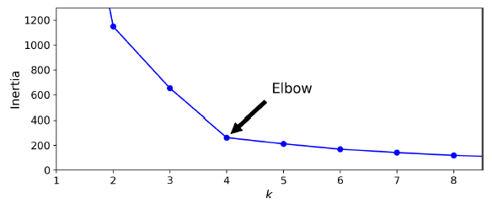
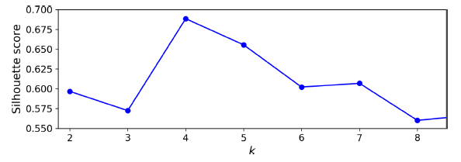
How to choose the number of clusters?
Inertia has elbow but not always enough to objectively choose k
Silhouette Score: Balancing distance to centroid with number of clusters
Notes:
VOTE NUMBER OF CLUSTERS

Slide 27
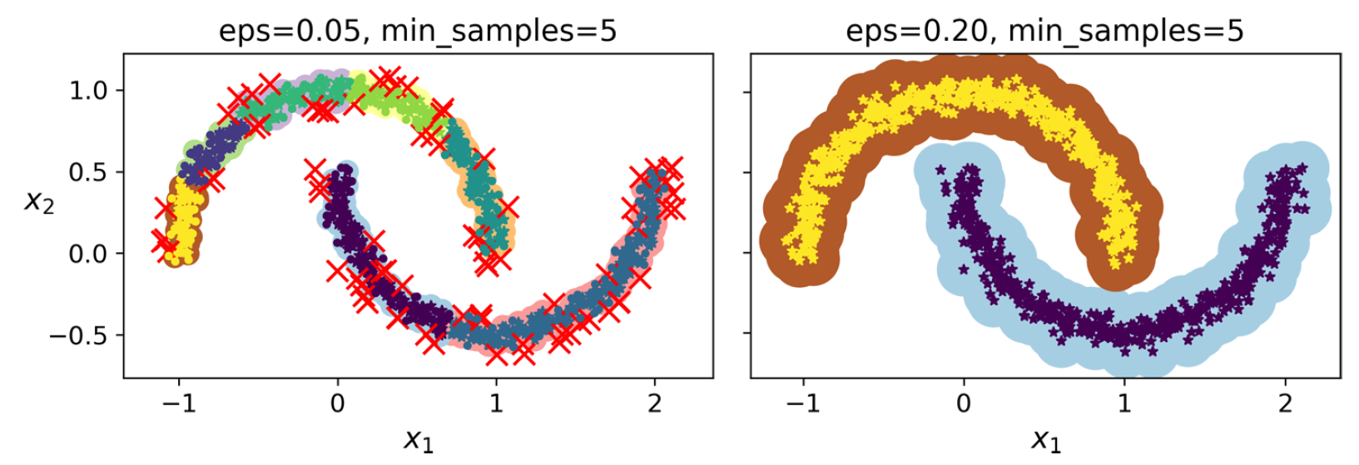
DBSCAN (Density-Based Spatial Clustering)
Hierarchical Clustering, Agglomerative Clustering, Spectral Clustering, etc.
Notes:
Other clustering algorithms include…
Conditions (question): the clusters must be dense enough and they must be separated by low-density regions

Slide 28
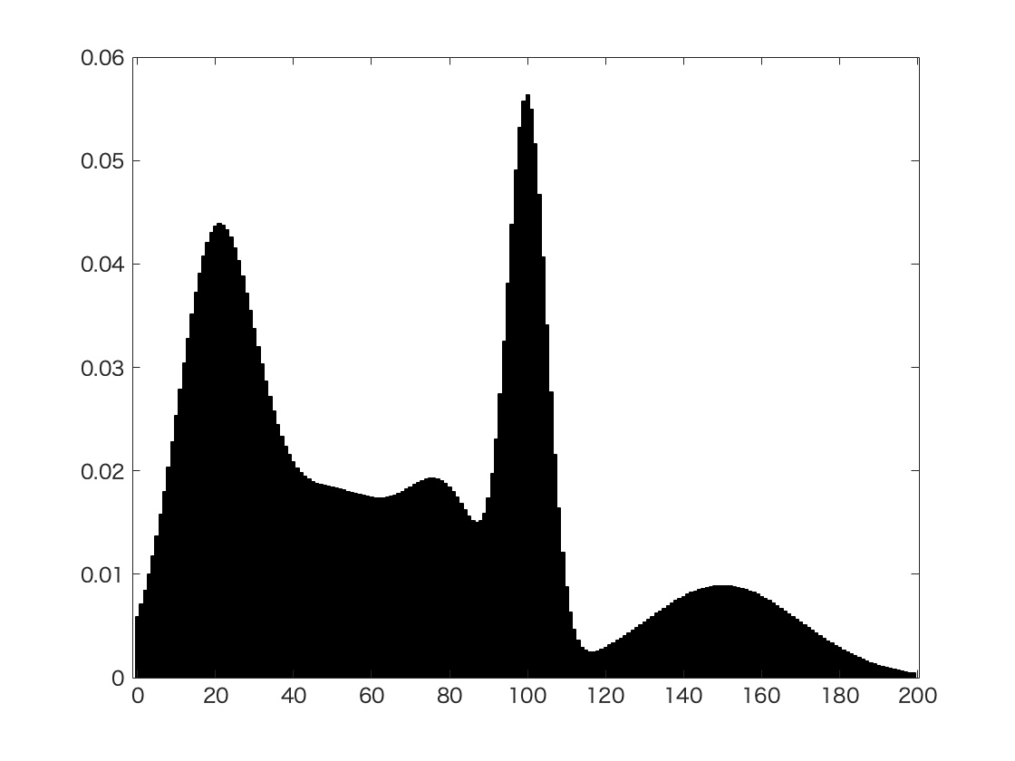
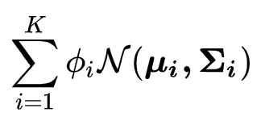
Gaussian Mixture Model = Sum Normal Distributions
Weights
Means
Covariances
Expectation-Maximization: Maximizes likelihood of being assigned to cluster
Source: Wikipedia

Slide 29
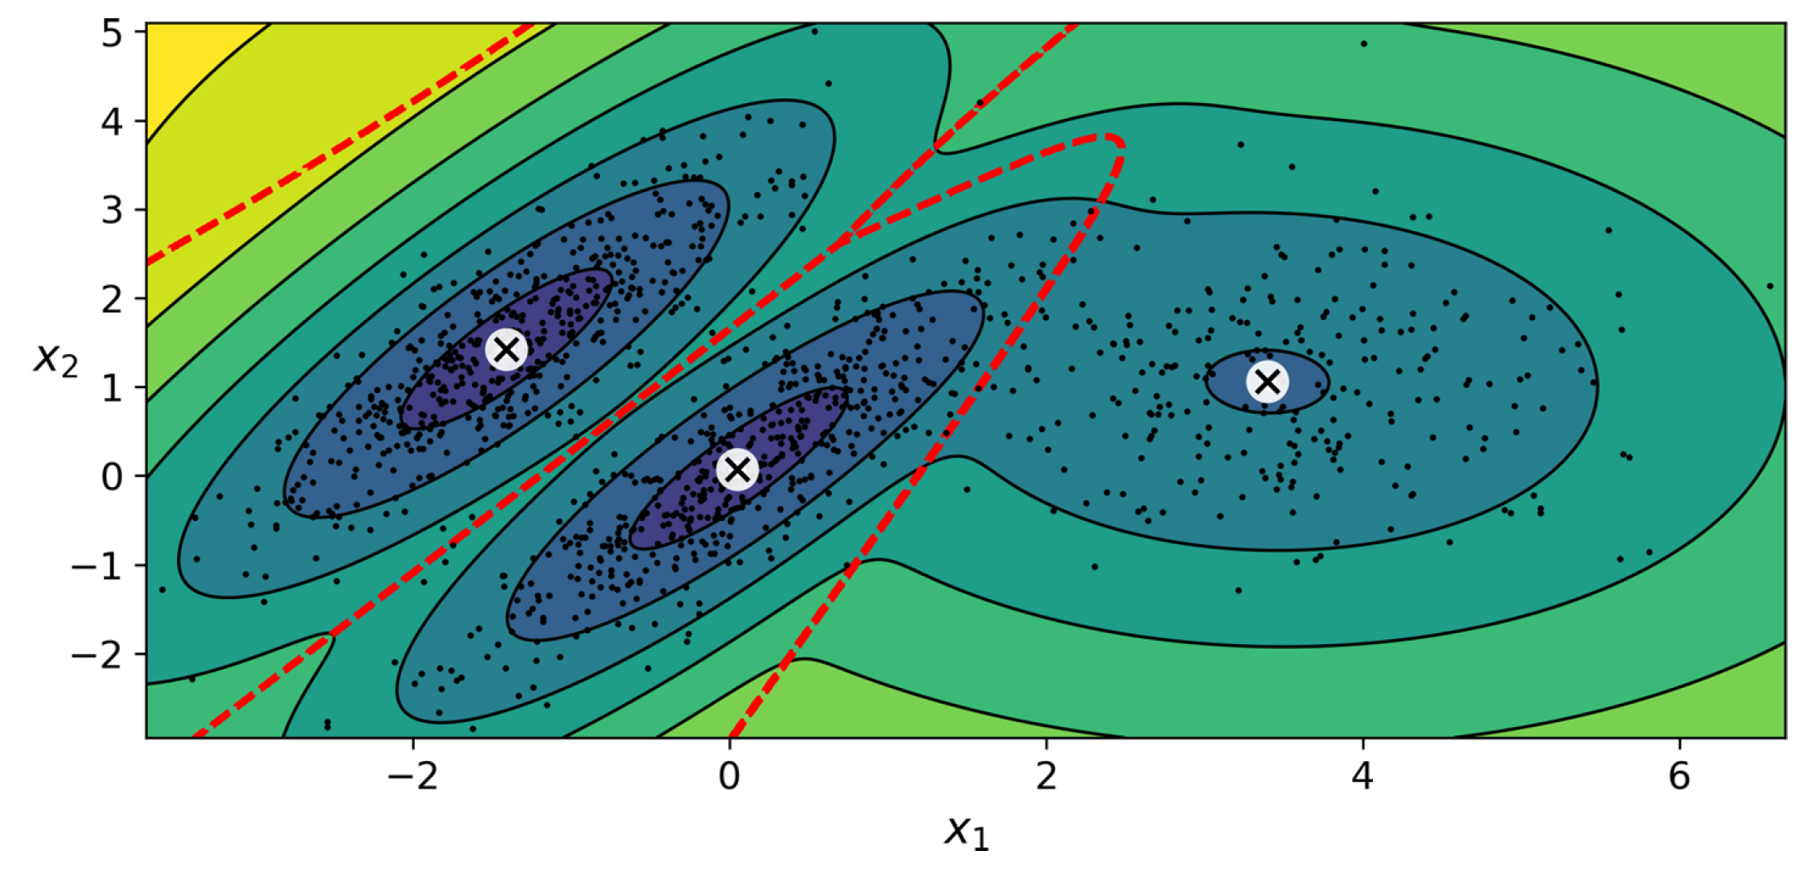
Means
Covariance matrices
Weight

Slide 30

Anomalies are points outside a given density threshold
Notes:
VOTE OUTLIERS?

Slide 31
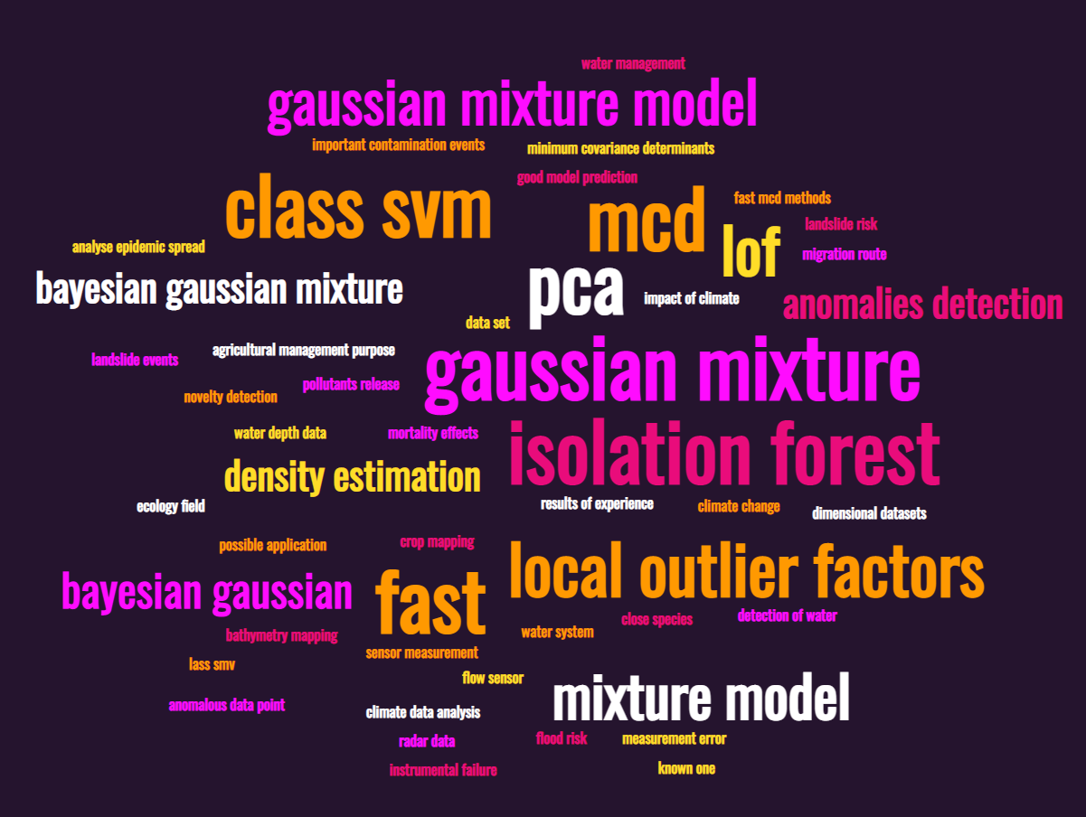
Other Algorithms for Anomaly Detection

Slide 32
How to objectively choose number of clusters?
Minimize Information Criterion:
Bayesian Info. Criterion = ln(#samples) x (#param) – 2 (Likelihood)
Founded in Bayesian stats, penalizing #param (complexity) and variance error
Akaike Info. Criterion = 2 (#param) – 2 (Likelihood)
Founded in information theory & meant to discourage overfitting
2) Bayesian Gaussian mixture models eliminate unnecessary clusters

Slide 33
Min 105-120: Review Moodle Quiz
Learning Objectives (Moodle Quiz at Min 45 on Géron Ch5+6+7):
Name Support Vector Machines & understand their applicability
Know how to train & interpret a decision tree
Understand how to choose a regularization hyperparameter
Define a random forest
Know some advantages/drawbacks of ensemble modeling
Understand feature importance
Notes:
Questions?
Not graded

Slide 34
Legacy Slides

Slide 35
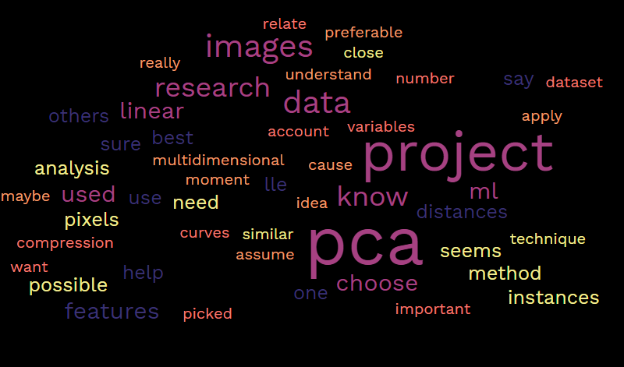
Fighting the curse of dimensionality
The higher the dimension, the higher the space. Therefore, the data will be more likely to be distant. This situation is not desirable because isolated data lose their usefulness. If we take for example 10 sampling points (of soil) in an area of 1m^2, we will have a good idea of the pesticide concentration. On the other hand, if we take 10 points in a 1m^3 cube, we will lose precision.
[…] the more features are used to describe data, the more isolated each datum point becomes and therefore the greater the risk of overfitting. Therefore, there is a tradeoff between the number of features considered individually and the generalization ability of the model.
(The) more we have information, the more samples is needed (this link grows exponentially). For example, if you want to know the predictions for the future climate. The more different factors we take, the more data we need to create our predictive model.

Slide 36
Question 3.3
Training Set
Validation Set
Test Set
Accuracy before decreasing complexity
0.92
0.51
0.56
Accuracy after decreasing complexity
0.21
0.15
0.18
Notes:
Know how to benchmark a regression model

Slide 37
Min 105-120: Review Moodle Quiz
Learning Objectives (Moodle Quiz at Min 45 on Géron Ch5+6+7):
Name Support Vector Machines & understand their applicability
Know how to train & interpret a decision tree
Understand how to choose a regularization hyperparameter
Define a random forest
Know some advantages/drawbacks of ensemble modeling
Understand feature importance
Notes:
Questions?
Not graded

Slide 38
Min 75-85: Unsupervised Learning to Elucidate Environmental Complexity
Learning Objectives (Géron Ch8):
How to reduce the dimensionality of an environmental dataset in practice?
What can we learn by clustering complex environmental datasets?
Re-read the article and write down (1) the scientific goal of the paper; (2) One simple question with your neighbor. Example: What is a dynamical regime?

Slide 39
Can we learn How the Oceanic Circulation will Change with Climate from Data?
Problem: - The full-complexity/depth ocean models are only reliable in the present
- Climate models used to predict the future only have a few reliable labels
Idea: Train a classifier to detect dominant circulation regime from labels
Result: Prediction of complex circulation changes with climate

Slide 40
What is a dynamical regime?
Dynamical regime: regions with similar drivers governing circulation
A dynamical regime is a climatic regime driven by dynamical terms such as (a) the wind and bottom stress curl, (b) the advection of planetary vorticity, (c) bathymetric interactions through bottom pressure torque (BPT), (d) curl of nonlinear interactions between terms and (e) lateral viscous dissipation from within the ocean interior.

Slide 41
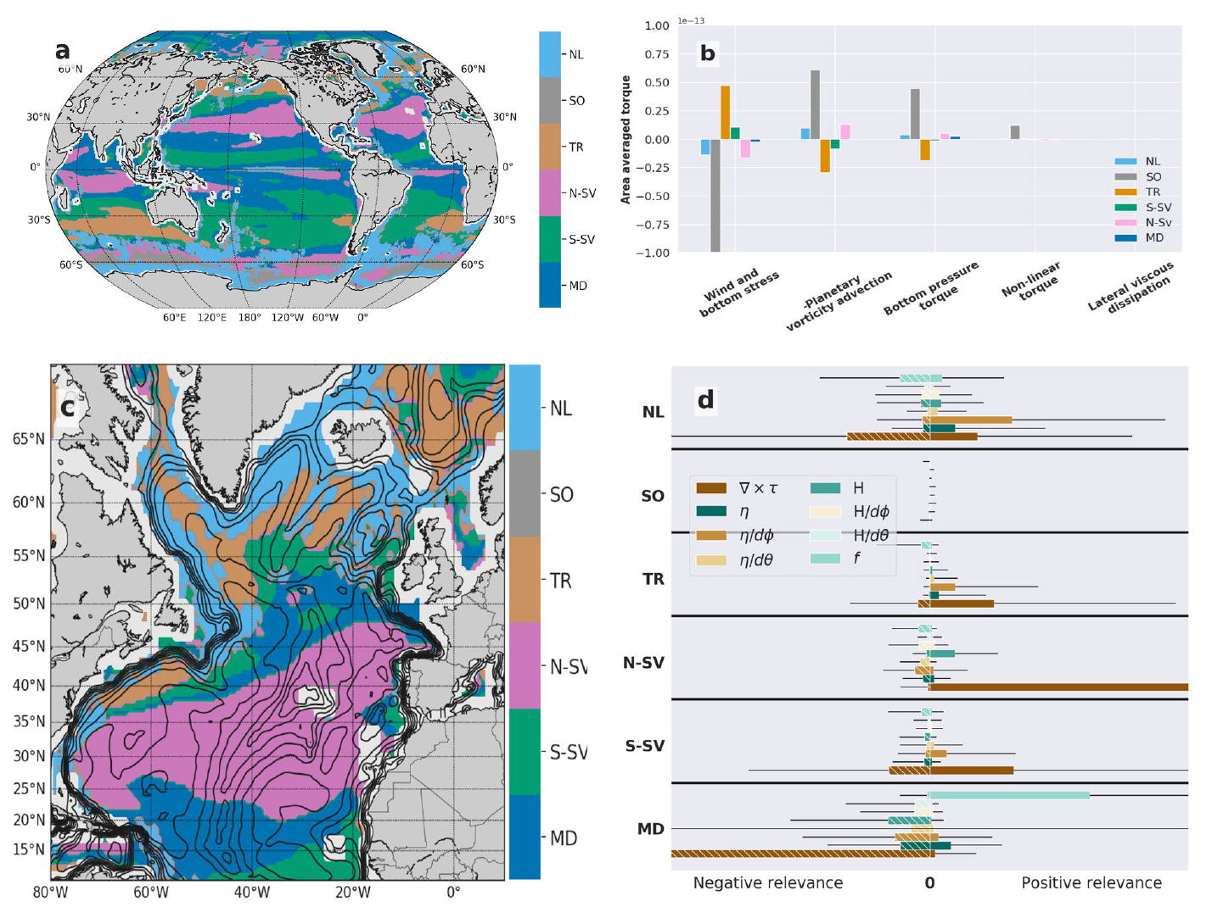
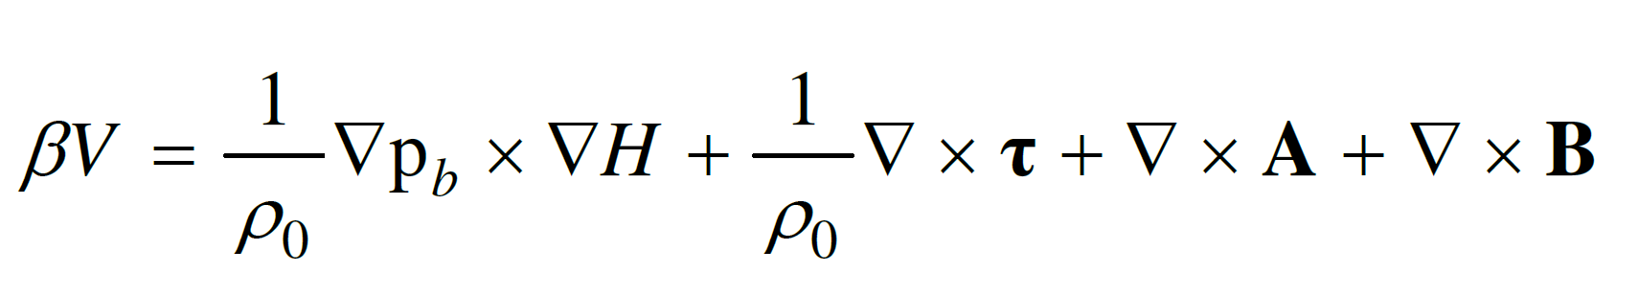
Bottom Pressure Forces
Small-scale eddies
North-South Circulation
Surface Wind Stress
Viscous Dissipation

Slide 42
Let’s pick a regime!
(Hand vote)

Slide 43
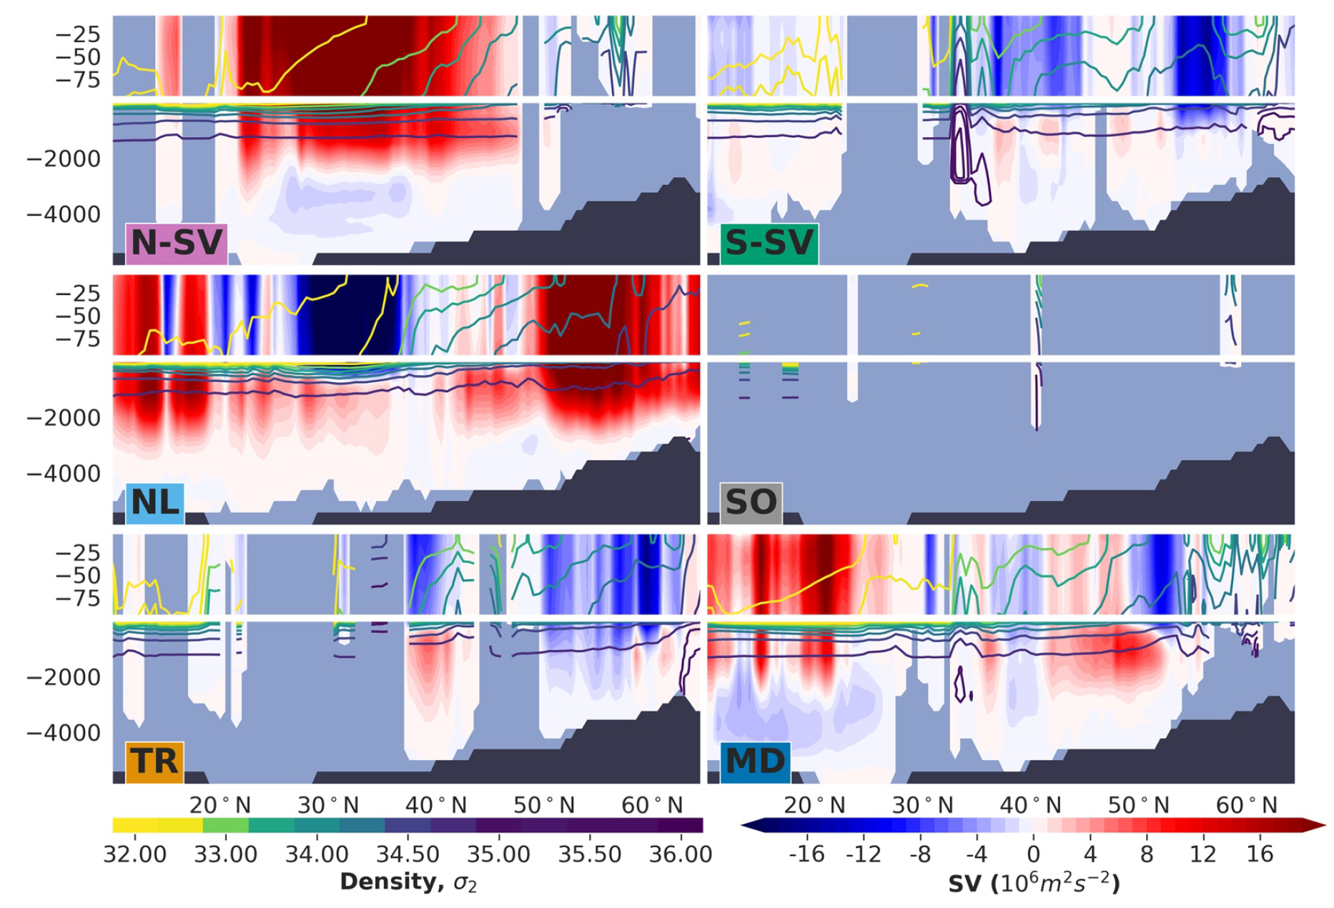
What is this dynamical regime’s vertical structure?

Slide 44
Which component(s) of the barotropic vorticity budget is most important to accurately predict that a given location is dominated by this regime?

Slide 45
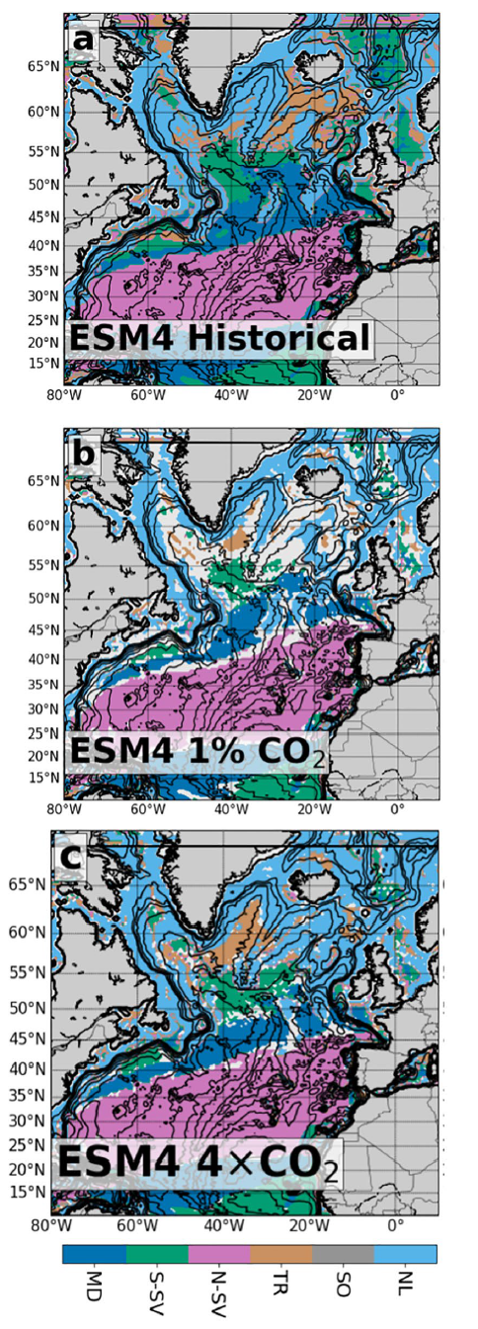
How is this dynamical regime expected to change in response to an increase in the atmospheric carbon dioxide concentration? Why?

Slide 46
Now let’s go back to the initial questions

Slide 47
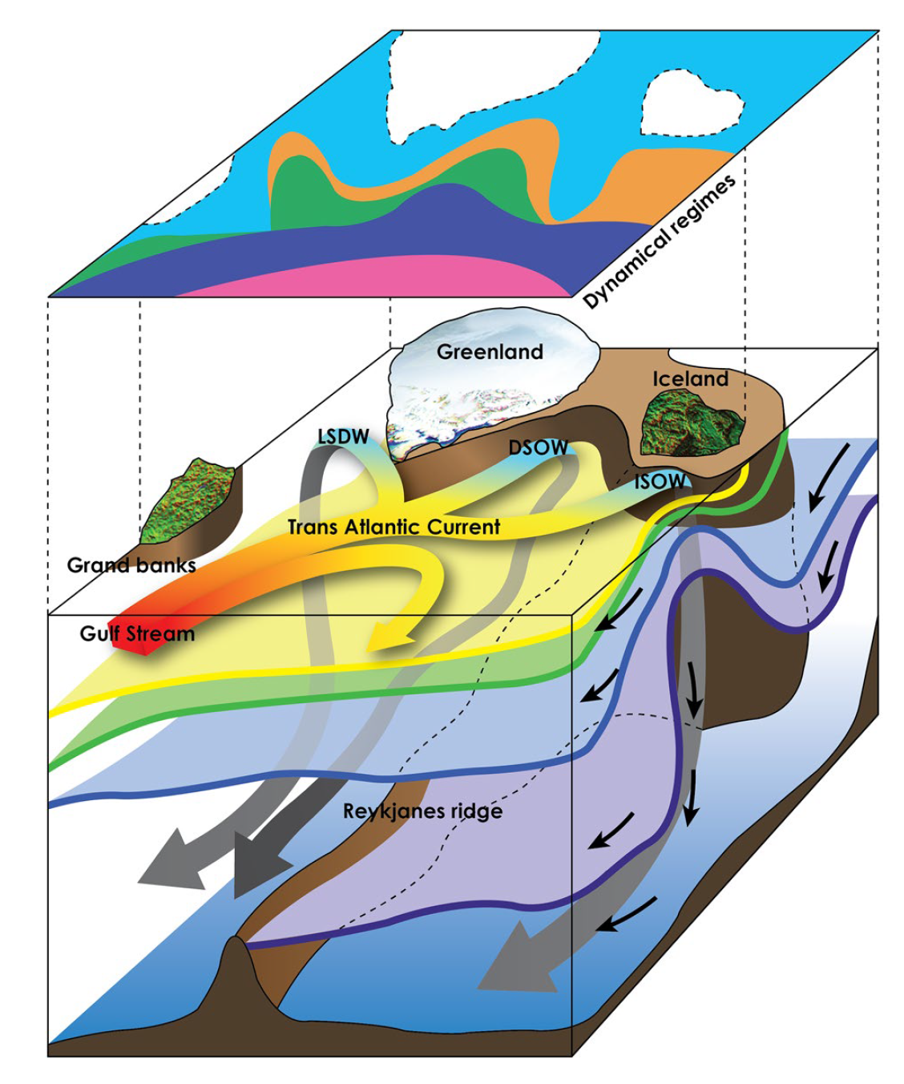

Slide 48
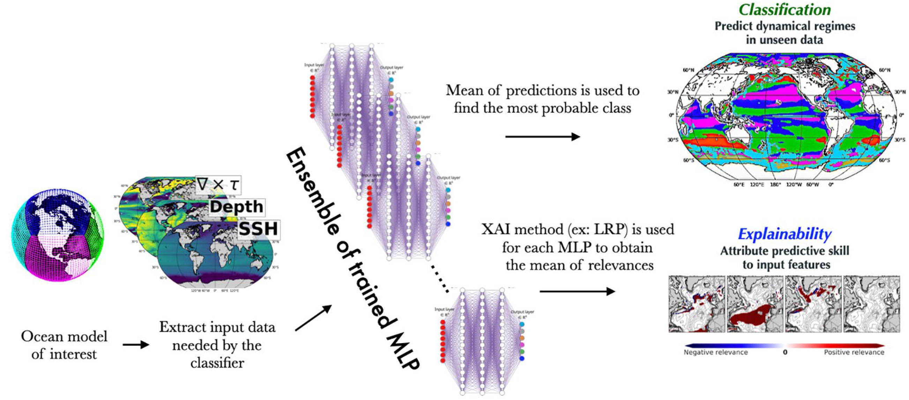

Slide 49
Start thinking about your final project and book a one-on-one meeting
The final project’s goal is to answer a well-defined scientific question by applying one of the ML algorithms introduced in class on an environmental dataset of your choice (e.g., related to your Masters thesis or your PhD research).
Can you think of a large environmental dataset linked to a scientific question you are passionate about?
In the affirmative, how could you format the dataset to facilitate its manipulation in Python?
In the negative, consider browsing the list of benchmark datasets maintained by Pangeo (http://mldata.pangeo.io/index.html), Kaggle, or browse the class syllabus’ datasets
One-on-one Meetings for Final Project: https://calendly.com/tom-beucler/final_project
If you have not already done so, register to the course by filling out this form: https://forms.gle/8fGjKU86XqZ3ghHu7
Notes:
Questions?

Slide 50


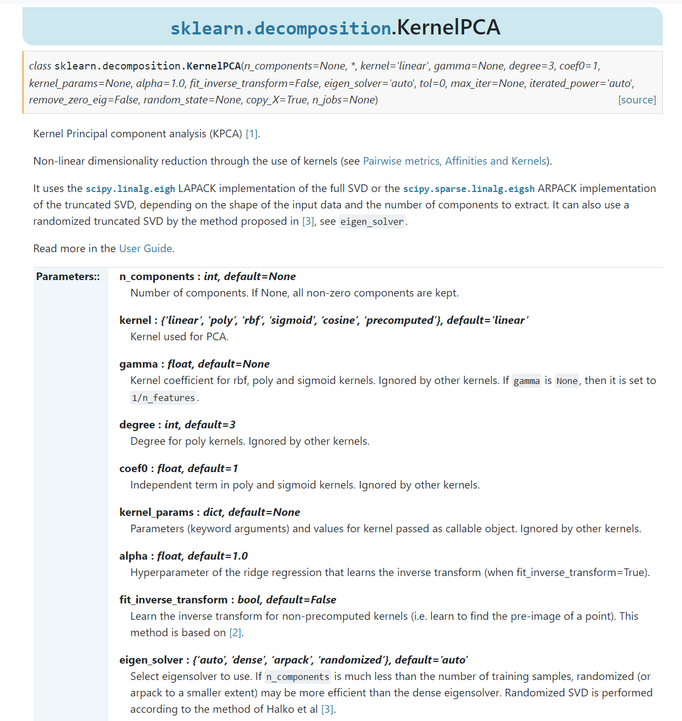
Kernel PCA = Using a kernel to compress more data in less components during PCA
Source: SVM with polynomial kernel visualization (Udiprod, Youtube)
Notes:
Describe steps in practice.

Slide 51
Questions
Is machine learning also commonly used to predict landslides, avalanches, rockslides, mudslides, floods and tidlewaves ?
Know that the susceptibility is mapped, how can we use it to prevent the wildfires ?
How does the amount of time spent implementing a ML algorithm for susceptibility mapping compare to time spent on traditional susceptibility mapping methods (ie. physically based models integrated into GIS)?
I didn't understand well the manipulation with the k-fold cross validation.
this study was done in a region in Italy- would it be easy to use it to predict susceptibility in other areas/has it been used in other areas of the world and how big of an area could it be used on at once?
can you explain question 4.2 please?
Could you have done a paper like this and come up with the same results without machine learning?
Did you test the model with spatial blocks of different sizes ? What is the result and why 15km by 15km.
Do you enjoy machine learning ?
How easily can this method be transformed into other natural hazards, like avalanches?
the comparison is interesting on the figure 4, but since the probability of fire should be way higher in the summer, shouldn't we adapt both graphs and express this greater risk?
What are the main questions related to the choice of the different model
Did this map was finally used by firefighters department in the studied region ?

Slide 52
Questions
Is this model also valid for others country or a new model has to be create again each time ?
Why was the data collected over a large time period , i,e., spanning a 21-year period (1997–2017). Would it have being better or worse to have less or more dataset temporally?
-
how wildfires evolved since 2017 and are they coherent with the maps?
No more time
Were these susceptibility maps effectively used by the Italian Fire fighters ? Did it show an important improvement in their fire fighting strategy?
Have you any post-2017 data to assess the evolution of wildfire management since then?
How do you decide on your parameters while making the susceptibility maps.
what's the advantage of using an increasing number of folds in the k-folds cross-validation in that study?

Slide 53
Questions
how would you choose which technique to use though? like how do you know what criteria is best for each one? (re like choosing the best one for our research project)
"1. I understand the appeal of incremental PCA as it reduces the RAM requirements. But how does iPCA affect global model fit? It seems like fragmenting the training dataset would decrease the quality of the training.
2. How does multidimensional scaling work? How does it differ from projections in a linear PCA?"

Slide 54
Questions
DBCAN isn't really clear for me, and the issue with unlabeled data
I am interested in learing about the environmental examples of applications of each method,
didn't understand the semi-supervised learning
could you please reexplain more thoroughly DBSCAN
Finding an example for everything really bothers me can you think of a way we can classify environmental problems so we can directly go to each category to choose from.
I didn't understand well the Bayesian Guassian Mixture models process

Slide 55
Questions
What does it mean for data to be labeled vs. unlabelled? Could you explain the different regimes further?
How can regimes like the SO, which exhibits very low learning contributions from any of the features, be sustained in this model? It seems like they would be highly uncertain considering how little the given features constrain them.
can you explain what are dynamical regime's vertical structures?
how do we discretise the complicated equations such as the overall meridional overturning? given the complexity of the systems

Slide 56
Min 45-60: Moodle Quiz (7 questions, 15 min)
Learning Objectives (Moodle Quiz at Min 45 on Géron Ch8+9):
Distinguish supervised from unsupervised learning
Understand the necessity of reducing dimensionality for big datasets
Know at least two approaches for dimensionality reduction
Understand the steps of Principal Component Analysis
Distinguish clustering from supervised classification
Know how to implement the K-means algorithm and select the number of clusters
Know how to implement Gaussian mixture models and how to detect anomalies
Notes:
Questions?
Not graded

